Slide 1

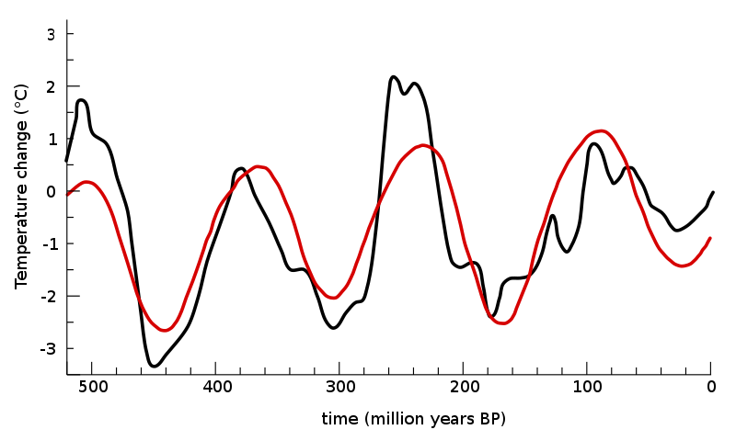
Lesson 4: Time Series & Machine Learning
Luis Miralles

Slide 2

Learning outcomes
What are time series?
Example I: Time series applied to Human Activity Recognition.
Learning time window, frequency and time domain features, etc.
Showcase II: Time series applied to predictive maintenance
Time series similarity measures, DTW, Threshold tunning, etc.
How can you apply ML to time series
What are Time Series Similarity Measures?

Slide 3
Summary of the lesson
A time series is a sequence of numerical data points recorded regularly. It is used for various applications, such as air quality and energy prediction.
The HAR process involves using an inertial measurement unit (IMU) and applying a time window to raw data to extract features.
Time series similarity measures, such as Dynamic Time Warping (DTW) and Symbolic Aggregate Approximation (SAX), are discussed for clustering time series data.

Slide 4
Presentation index
INDEX: 1.- What is Time Series, and its relationship with Machine Learning? 2.- Time series supervised learning: Human activity recognition 3.- Time series unsupervised learning: Similarity measures 4.- Time series clustering

Slide 5
My experience with Time Series
Ponce, Hiram, María De Lourdes Martínez-Villaseñor, and Luis Miralles-Pechuán. "A novel wearable sensor-based human activity recognition approach using artificial hydrocarbon networks." Sensors 16.7 (2016): 1033.
Ponce, Hiram, Luis Miralles-Pechuán, and María De Lourdes Martínez-Villaseñor. "A flexible approach for human activity recognition using artificial hydrocarbon networks." Sensors 16.11 (2016): 1715.
Sayakkara, A., Miralles, L., Le-Khac, N. A., & Scanlon, M. (2020). Cutting through the Emissions: Feature Selection from Electromagnetic Side-Channel Data for Activity Detection. Forensic Science International: Digital Investigation.
Miralles‐Pechuán, Luis, Ankit Kumar, and Andrés L. Suárez‐Cetrulo. "Forecasting COVID‐19 cases using dynamic time warping and incremental machine learning methods." Expert Systems (2023): e13237.
18 months project

Slide 6

Section 1: What are Time Series and their relationship with Machine Learning?

Slide 7
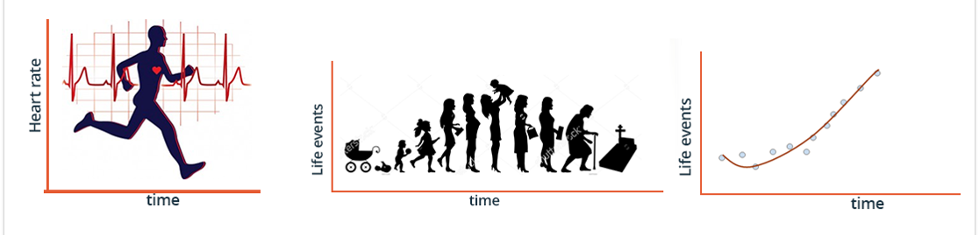
What are Time Series?
A time series is a sequence of numerical data points in successive order with data points recorded at regular intervals.

Slide 8
Examples
Demand for a product
Text messages
Internet traffic
Number of WhatsApp’s
Number of views on YouTube
Population of deer
Air quality
Energy prediction
Traffic
Buzz in social media
Sold cars per month
Stock market
Heartbeat
Number of infections
Number of births
Temperature
http://timeseriesclassification.com/dataset.php
https://archive.ics.uci.edu

Slide 9
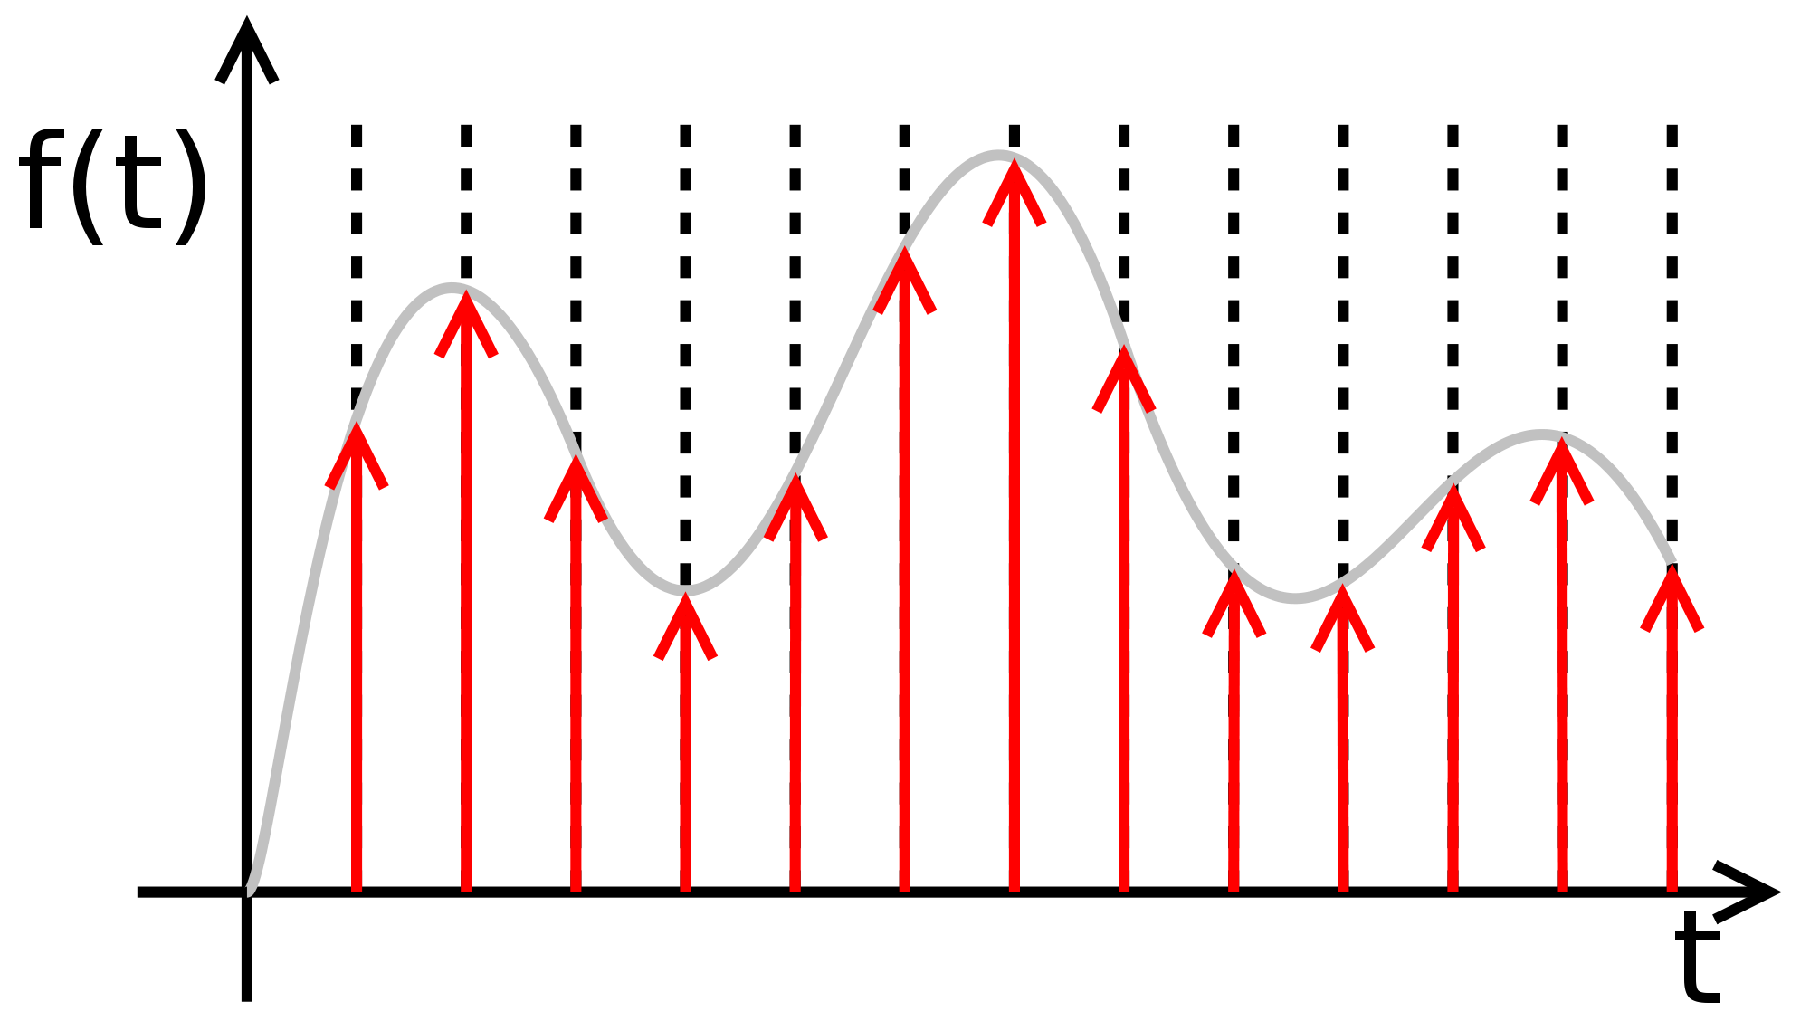
Sampling techniques
Sampling is the process of transforming continuous data into discrete data.
There are two ways of sampling: one based on time (Riemann) and the other based on the behaviour of the signals (Lebesgue).

Slide 10
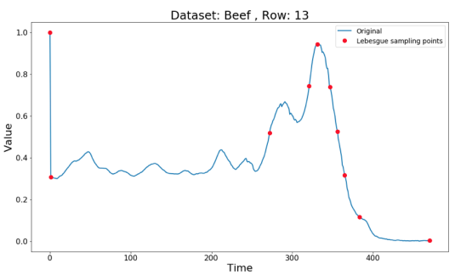
Lebesgue sampling
Riemann sampling captures the information from the continuous signals at equidistant time intervals (every second, every minute, etc.).
Lebesgue samples take points depending on the behaviour of the signal.

Slide 11
Basic approaches with time series
Classification
Regression
Clustering
Supervised
Unsupervised

Slide 12
Time series regression
Metrics:
RMSE
MSE…

Slide 13
Time series classification
Acc,
F-Score,
Precision…

Slide 14
Time series clustering

Slide 15

Section 2: Example of a Time Series pipeline using HAR

Slide 16
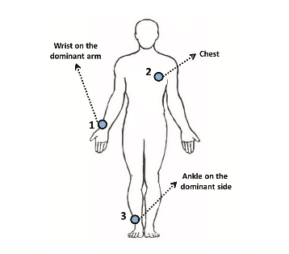
Overview of the HAR process
Intrusive
Sensors

Slide 17
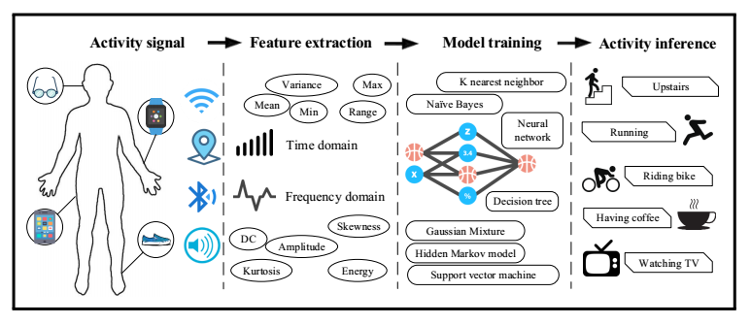
Overview of the HAR process

Slide 18
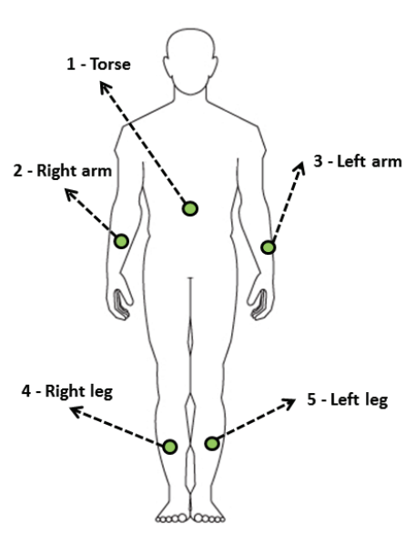
IMU: Inertial measurement unit
An inertial measurement unit (IMU) is an electronic device that measures and reports a body's specific force, angular rate, and sometimes the magnetic field.
The Accelerometer measures total acceleration.
The magnetometer measures the magnetic field.
The Gyroscope measures your instantaneous angular momentum.
IMUs can manoeuvre aircraft, including unmanned aerial vehicles (UAVs), spacecraft, satellites, and landers.

Slide 19
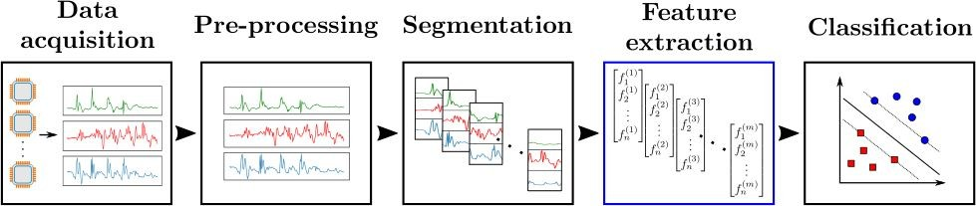
Typical steps of a pipeline for Human Activity Recognition

Slide 20
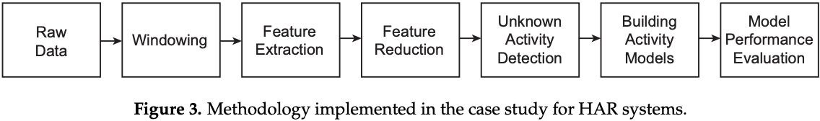
Methodology for HAR systems

Slide 21
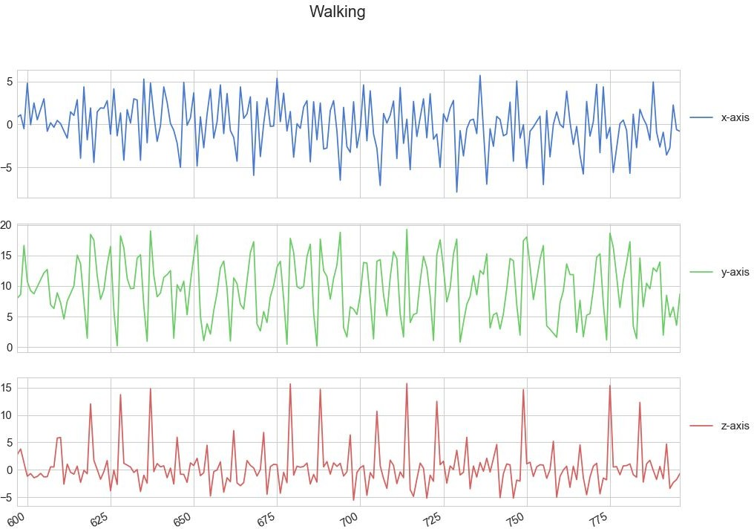
Values per axis for the walking activity

Slide 22
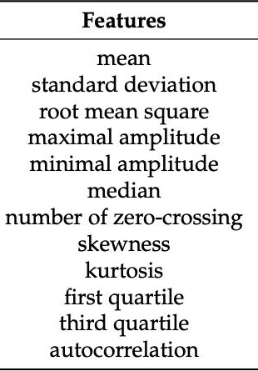
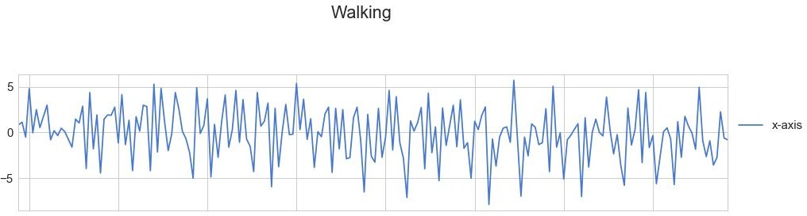
How to apply a time window to raw data
1
1
1000
2000
12

Slide 23
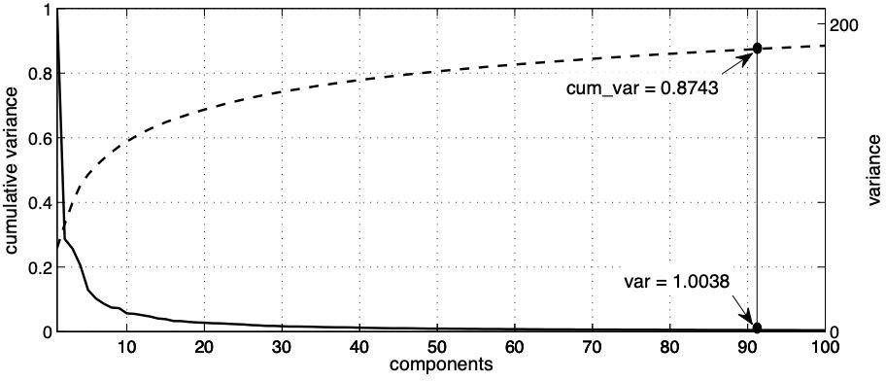
PCA: Principal component analysis

Slide 24
Values per axis for the walking activity

Slide 25
Applying a time window to raw data

Slide 26
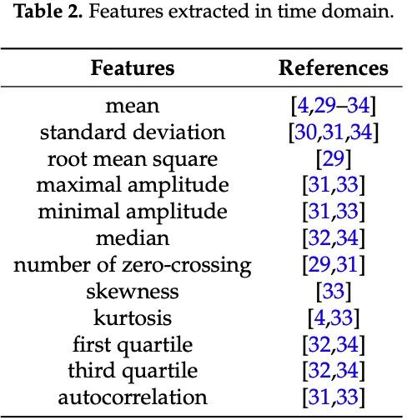
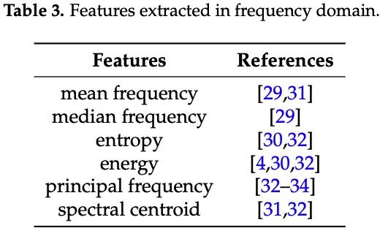
Feature extraction from the window

Slide 27
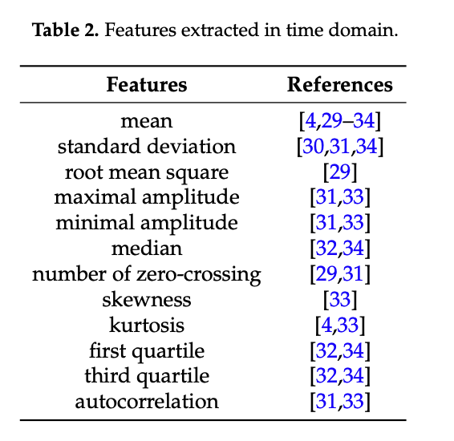
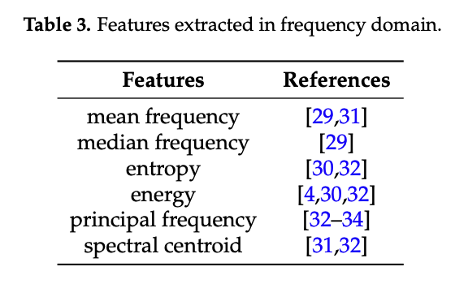
Feature extraction from the window
Frequency
Time

Slide 28
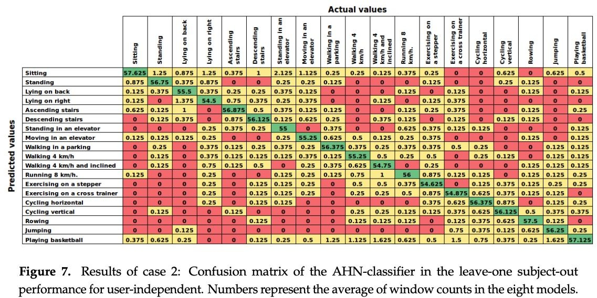
Confusion matrix

Slide 29
Section 3: Feature selection in HAR

Slide 30
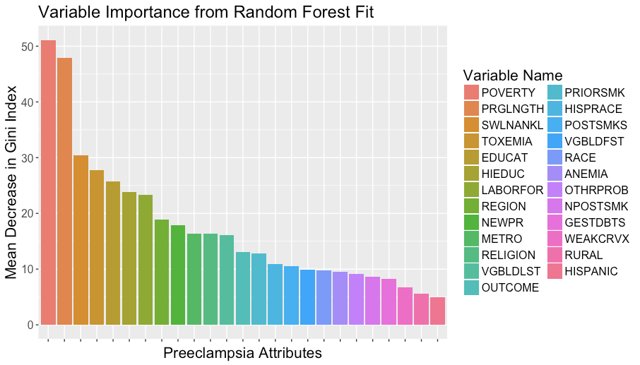
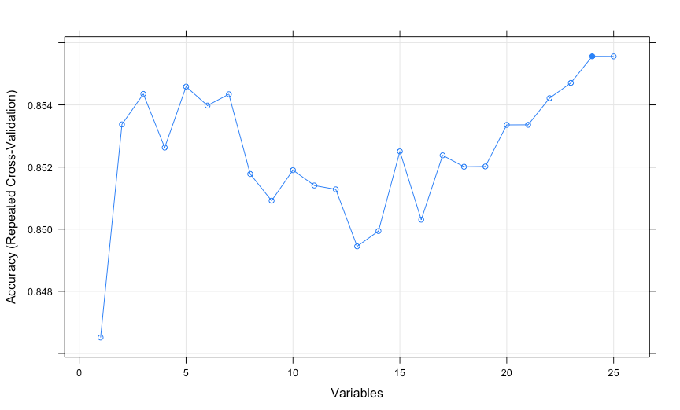
Feature selection saves time and improves accuracy
Selecting features individually
Selecting features by subsets
Filter vs Wrapper

Slide 31
What is Feature selection?
It saves time, it creates more accurate models, it uses less computer resources, it is easier to understand

Slide 32
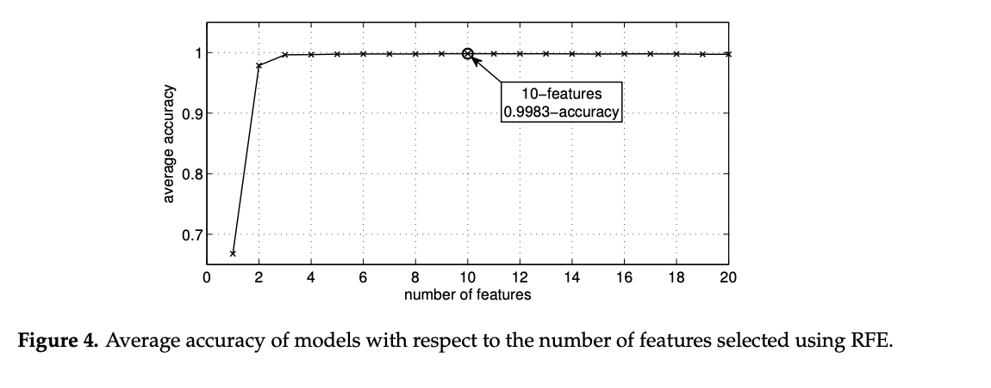
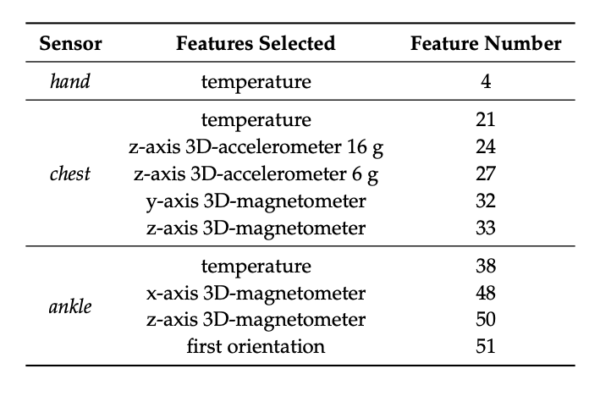
Feature selection in HAR

Slide 33
Confusion matrix

